Slide 1
Disorders of lipid metabolism
By
Dr.Qutaiba A. Qasim
PhD. Clinical Biochemistry
2020

Slide 2
DISORDERS OF LIPID METABOLISM

Slide 3
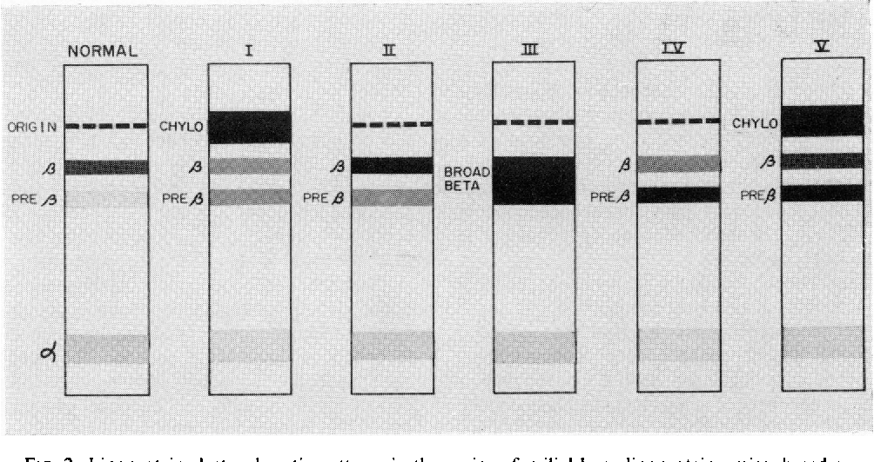
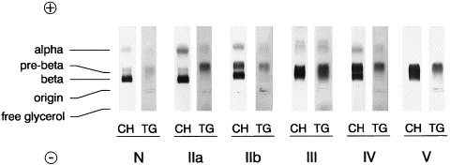

Slide 4
1-Chylomicron syndrome
Causes:
1-Lipoprotein lipase deficiency.
2-Circulating inhibitors of lipoprotein lipase.
3-ApoC2 deficiency.
Clinical features:
Abdominal pain (often with acute pancreatitis) is typical., Lipid stigmata include eruptive xanthomata,hepatosplenomegaly and lipaemia retinalis .
To confirm the diagnosis of familial lipoprotein lipase deficiency,
plasma lipoprotein lipase can be assayed after the intravenous administration of heparin, which releases the enzyme from endothelial sites. The assay is
complicated in that other plasma lipases (hepatic lipase and phospholipase, for example) contribute to the overall plasma lipase activity. Inhibition of lipoprotein lipase can be performed using protamine, high saline
concentrations or specific antibodies and its overall activity can be calculated by subtraction.

Slide 5
Creamy layer and Lipaemia retinalis

Slide 6
2-Familial hypercholesterolaemia (FH)
Causes:
At least five types of mutation of the LDL receptor have been described, resulting in reduced synthesis, failure of transport of the synthesized receptor to the Golgi complex within the cell, defective LDL binding or inadequate expression or defective recycling of the LDL receptor at the cell surface.
Clinical features:
plasma cholesterol concentration of more than 7.5 mmol/L in an adult (more than 6.7 mmol/L in children under 16 years) or a plasma LDL cholesterol concentration of more than 4.9 mmol/L in an adult in the presence of tendon xanthoma. with a relatively normal plasma triglyceride . type IIa and type IIb phenotype .
The diagnosis of FH : assay of the LDL receptors and (DNA) screening is now important

Slide 7
Tendinous xanthomas and Corneal arcus in familial hypercholesterolaemia.

Slide 8
3-Familial defective apoB3500
Causes: mutation in the apoB gene resulting in a substitution of arginine at the 3500 amino acid position for glutamine. Apolipoprotein B is the ligand upon the LDL particle for the LDL receptor.
It may be indistinguishable clinically from FH and is also associated with hypercholesterolaemia and premature
coronary artery disease.

Slide 9
4-Familial combined hyperlipidaemia (FCH)
Plasma cholesterol and plasma triglyceride are elevated . The Fredrickson’s phenotypes seen in this condition include IIa, IIb and IV.
Plasma apoB is often elevated due to increased synthesis; LDL and VLDL .
The diagnosis can be difficult and it sometimes needs to be distinguished from FH (xanthomata are not usually present in FCH) and familial hypertriglyceridaemia (the IIa and IIb phenotypes are not usually found in familial hypertriglyceridaemia, although they are in FCH).
Children with FCH usually show hypertriglyceridaemia and not the type IIa phenotype (unlike the situation found in FH). Unlike familial hypertriglyceridaemia, plasma VLDL particles are usually smaller in FCH.

Slide 10
5-Familial hypertriglyceridaemia
Overproduction of VLDL or a decrease in VLDL conversion to LDL is likely . Often observed with low HDL cholesterol concentration.
Acute pancreatitis may also occur and is more likely
when the concentration of plasma triglycerides is more than 10 mmol/L. Some patients show hyperinsulinaemia and insulin resistance.

Slide 11
6-Type III hyperlipoproteinaemia
Also called familial dysbetalipoproteinaemia
or broad b-hyperlipidaemia. The underlying biochemical defect is one of a reduced
clearance of chylomicron and VLDL remnants. The
name broad b-hyperlipidaemia is sometimes used
because of the characteristic plasma lipoprotein
electrophoretic pattern that is often observed (the
broad b-band that is seen being remnant particles).
The palmar striae (palmar xanthomata), hypercholesterolaemia and hypertriglyceridaemia, HDL
cholesterol concentration is usually low . The diagnosis is ultracentrifugation to separate the lipoprotein particles.

Slide 12
7-Hyperalphalipoproteinaemia
Elevated plasma HDL cholesterol concentration, total plasma cholesterol concentration can be elevated, with normal LDL cholesterol concentration. There is no increased prevalence of cardiovascular disease . Some causes of raised plasma high-density lipoprotein (HDL) cholesterol :
Primary
Hyperalphalipoproteinaemia
Cholesterol ester transfer protein deficiency
Secondary
High ethanol intake
Exercise
Certain drugs, e.g. estrogens, fibrates, nicotinic acid,
statins, phenytoin, rifampicin

